Slide 1


Express Eats: A Recipe Blog Website
Express Eats is a new website that provides recipes, culinary tips, and a vibrant food community. The website is designed to be user-friendly, visually appealing, and packed with delicious content.

Slide 2
About Express Eats
Express Eats is a recipe blog website dedicated to sharing exciting and simple recipes for everyday cooking. It's designed to help home cooks of all skill levels.
The blog features a diverse range of recipes from around the world, covering everything from appetizers and desserts to main courses and snacks.

Slide 3

Technology Stack
HTML
CSS
For structuring the content and layout of the website.
For styling the website to make it visually appealing and user-friendly.
JavaScript
For adding interactivity and features to the website.

Slide 4


Engaging Content
High-Quality Recipes
Step-by-Step Instructions
Each recipe is carefully crafted and tested to ensure it's delicious and easy to follow.
Clear and concise step-by-step instructions to guide users through the process.

Slide 5
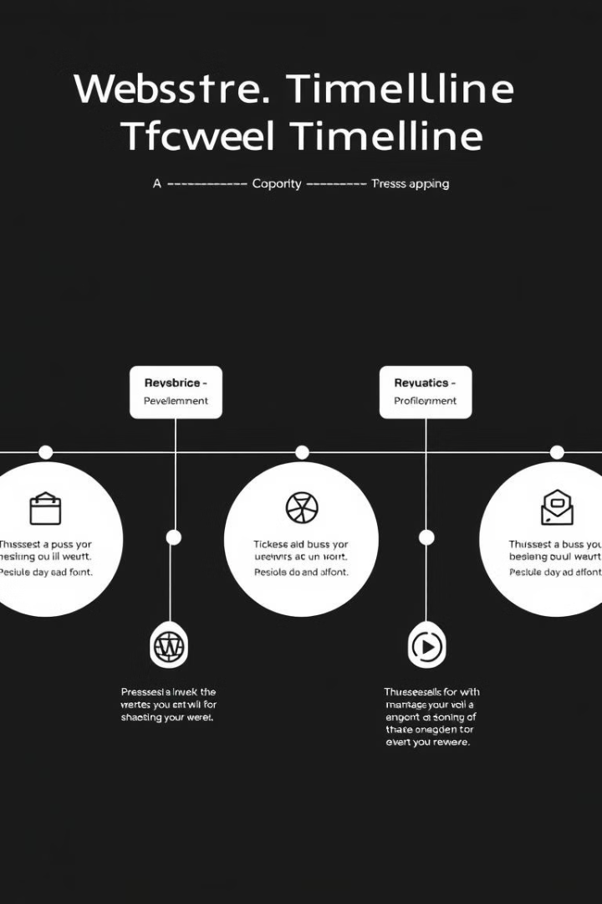
Future Plans and Roadmap
1
Integration with social media platforms to increase engagement and reach a wider audience.
2
Development of mobile apps to enhance accessibility and user experience for on-the-go cooking.
3
Expanding the recipe library to include more diverse cuisines and dietary preferences.

Slide 6
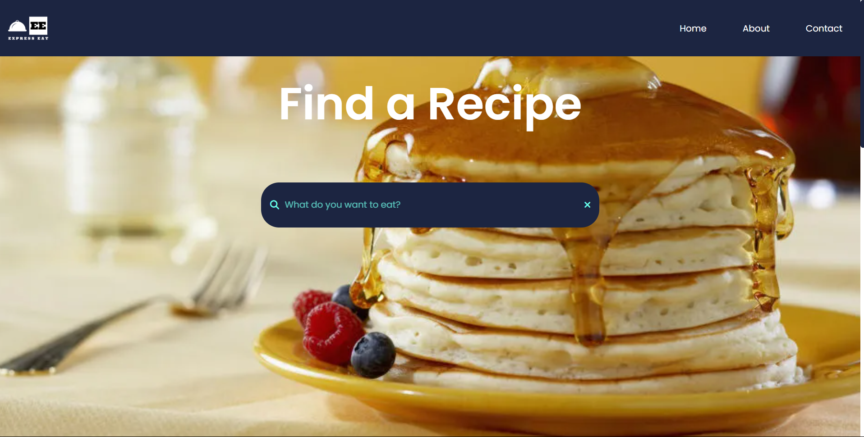
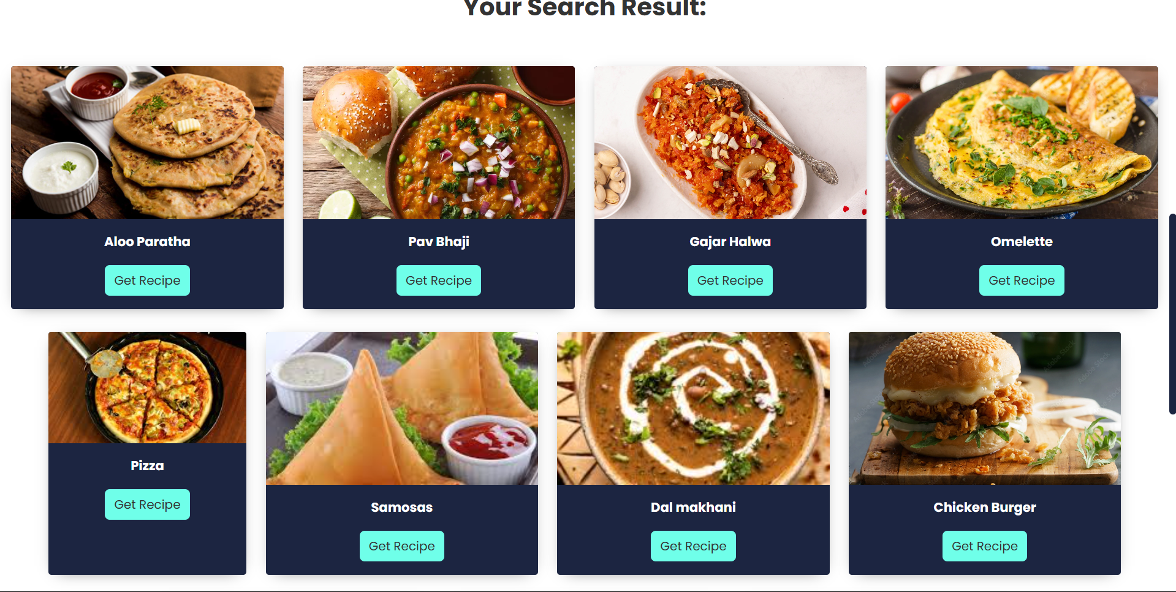
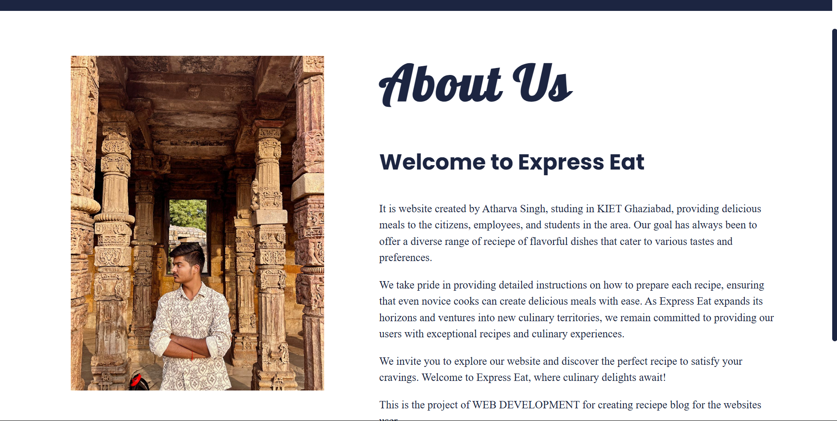
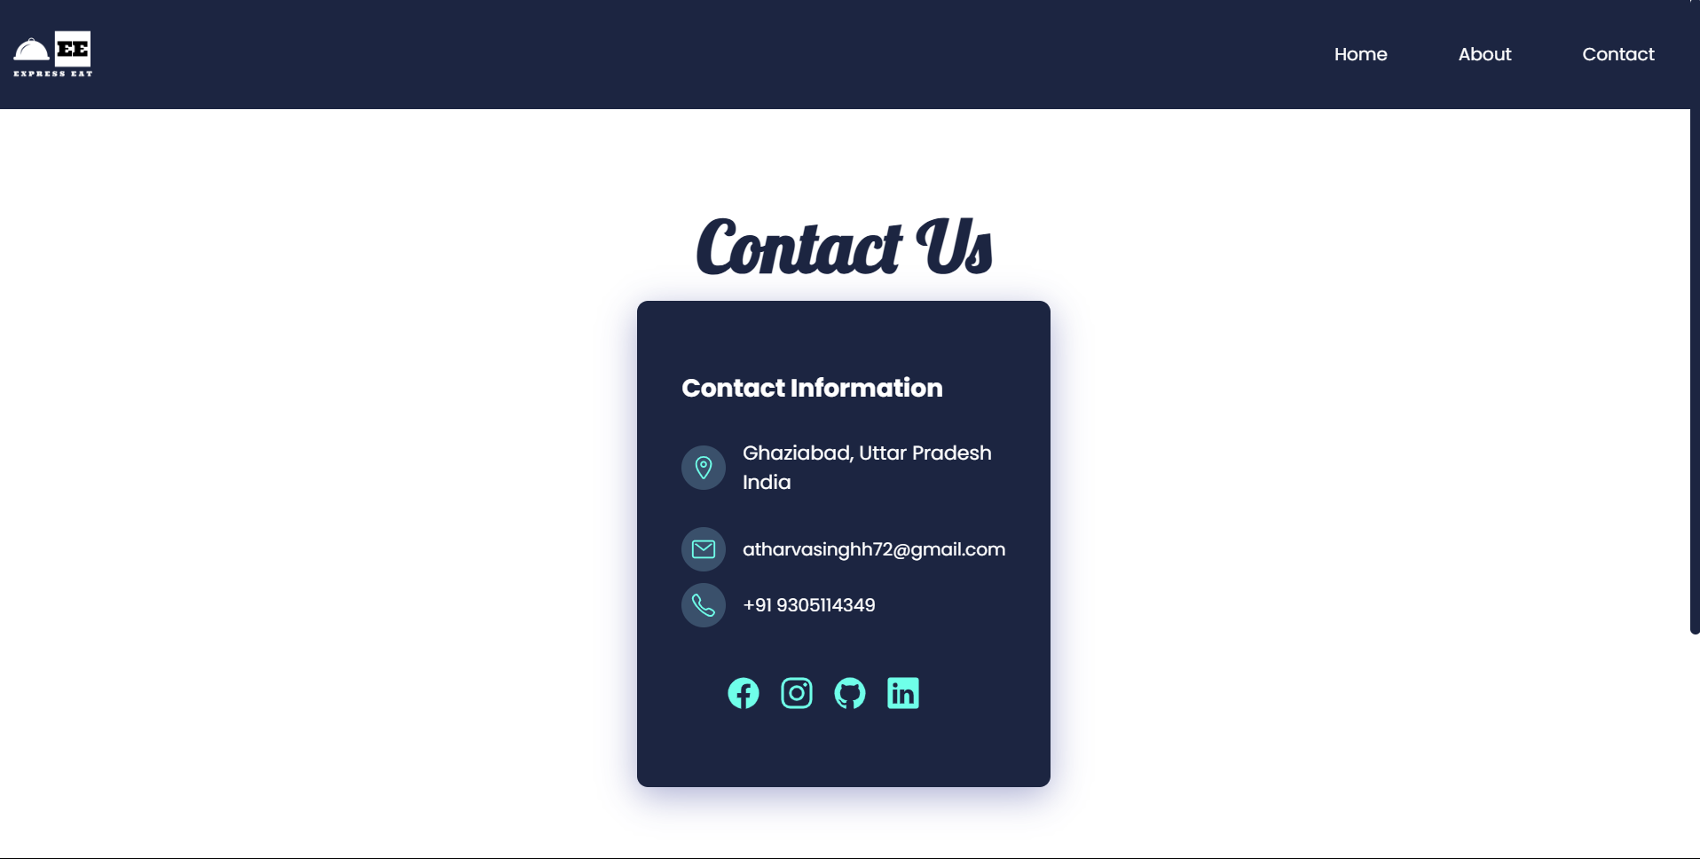
SNAPSHOTS OF THE WEBSITE

Slide 7

Conclusion
Express Eats aims to be a leading destination for home cooks, providing a user-friendly platform for discovering, sharing, and enjoying delicious recipes. The website will continue to grow and evolve, offering exciting new features and content.

